Slide 1

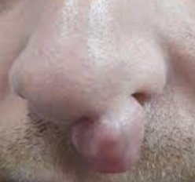
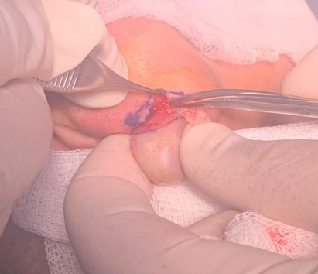
N° Poster
16
Chondroid Syringoma of the Nasal Dorsum: A Rare Benign Tumor in Adolescents
Chebbi Gh, Lansari S, Grira M, Sboui I, Hellal S, Mnif Z, Ben Youssef S, Naija S.
Maxillo Facial Surgery Department - Military Hospital of Tunis
Introduction :
Chondroid syringoma is a rare benign adnexal neoplasm that exhibits both epithelial and mesenchymal components. These tumors typically arise in the head and neck region, most commonly on the scalp, cheek, and upper lip. However, involvement of the nasal dorsum is exceedingly rare.
Objective:
To describe clinical, histopathological, and therapeutic features of a rare case of chondroid syringoma located on the nasal dorsum.
Observation:
We report the case of a 15-year-old female patient with no medical history, presenting with a swelling on the nasal dorsum that had been progressively increasing in size over one year.
Results :
Clinical examination: a firm, polylobulated, mobile, non-inflammatory,
and painless mass measuring approximately 3 cm. (Fig 1)
Treatment: complete surgical excision under local anesthesia, via a direct approach, without involving the alar cartilage. (Fig 2)
Histopathological examination: confirmed the diagnosis of a chondroid syringoma, a benign adnexal tumor with both epithelial and mesenchymal components with clear surgical margins.
The postoperative course was uneventful, with no recurrence or malignant transformation after 18 months of follow-up.
Conclusion:
Chondroid syringoma is a rare tumor in the nasal region, particularly in adolescents. The diagnosis is strictly histological. Complete surgical excision remains the cornerstone of treatment and ensures the absence of recurrence. Long-term clinical monitoring is recommended.
Fig 1
Fig 2

